Slide 1
Multi-Process TCP Server
School of Information and Communication Technology,
Hanoi University of Science and Technology

Slide 2
References
[1] W.Richard Stevens, Unix Network Programming Vol.1, 3rd Ed., Prentice Hall.
[2] Keir Davis, John W. Turner, and Nathan Yocom, The Definitive Guide to Linux Network Programming, Apress.
[3] Michael Donahoo, Kenneth Calvert, TCP/IP Sockets in C: Practical Guide for Programmers, Elsevier.

Slide 3
Content
Forking Server
Signaling
Signal Handling

Slide 4
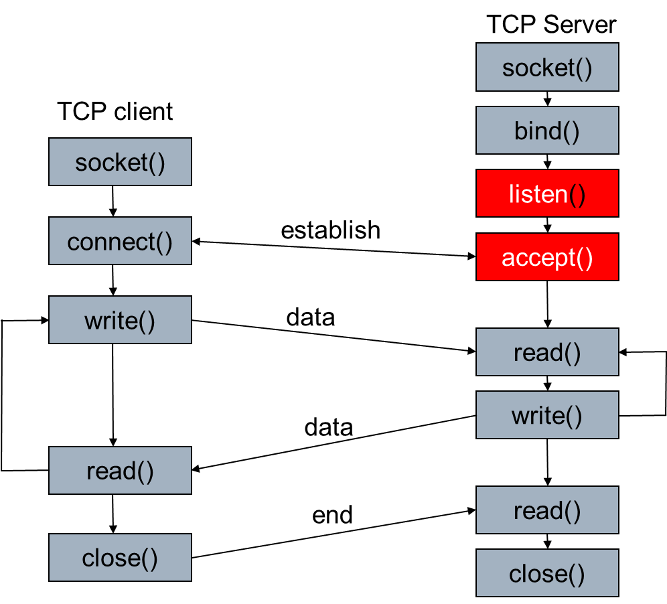
Single-client Server

Slide 5
Fork process
fork is an operation where a process creates a copy of itself
Happen in multitask operating system when a process launch another process → child process
The parent process makes a copy of its memory and gives to the child process
Fork system call is first introduced in UNIX.
First process in Linux is “init”
#include <unistd.h>
pid_t fork(void);

Slide 6
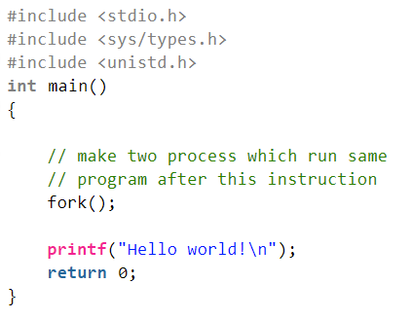
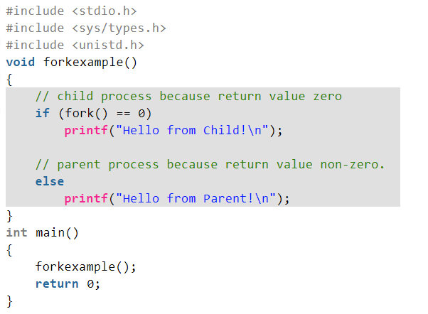
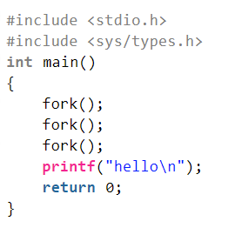
fork examples

Slide 7
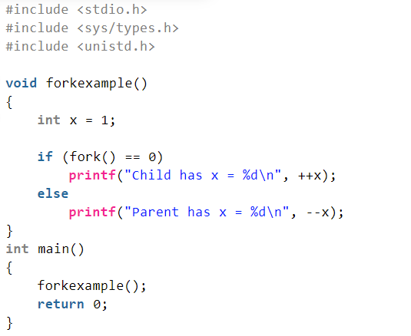
fork examples

Slide 8
fork
pid_t pid;
int listenfd, connfd;
listenfd = socket( ... );
/* fill in sockaddr_in{} with server's well-known port */
bind(listenfd, ... );
listen(listenfd, 5);
for ( ; ; ) {
  connfd = accept (listenfd, ... ); /* probably blocks */
  if((pid = fork()) == 0) {
    close(listenfd); /* child closes listening socket */
    doit(connfd); /* process the request */
    close(connfd); /* done with this client */
    exit(0); /* child terminates */
  }
  close(connfd); /* parent closes connected socket */
}

Slide 9
Child Process Termination
We use forking server, when a child process ends, it sends the SIGCHLD signal to the parent
  Information about the child process is still maintained in “process table” in order to allow its parent to read the child exit status afterward.
If SIGCHLD is ignored
  Child process will not running but still consumes system resources (in process table)
  → it is in zombie state
We need to handle SIGCHLD signal
  Make the child process to wait until the parent read its exit status
  once the exit status is read via “wait” system call, the zombie's entry is removed from the process table

Slide 10
Signaling
A signal is a notification to a process that an event has occurred.
Signals are sometimes called software interrupts.
Signals usually occur asynchronously.
  A process doesn't know ahead when a signal will occur.
Signals can be sent
  By one process to another process (or to itself)
  By the kernel to a process

Slide 11
Signaling
Typing certain key combinations at the controlling terminal of a running process causes the system to send it certain signals:
  Ctrl-C sends an INT signal ("interrupt", SIGINT)
  Ctrl-Z sends a TSTP signal ("terminal stop", SIGTSTP)
  Ctrl-\ sends a QUIT signal (SIGQUIT)
    by default, this causes the process to terminate and dump core.
SIGHUP is sent to a process when its controlling terminal is closed (a hangup).
SIGTERM is sent to a process to request its termination.
  Unlike the SIGKILL signal, it can be caught and interpreted or ignored by the process.

Slide 12
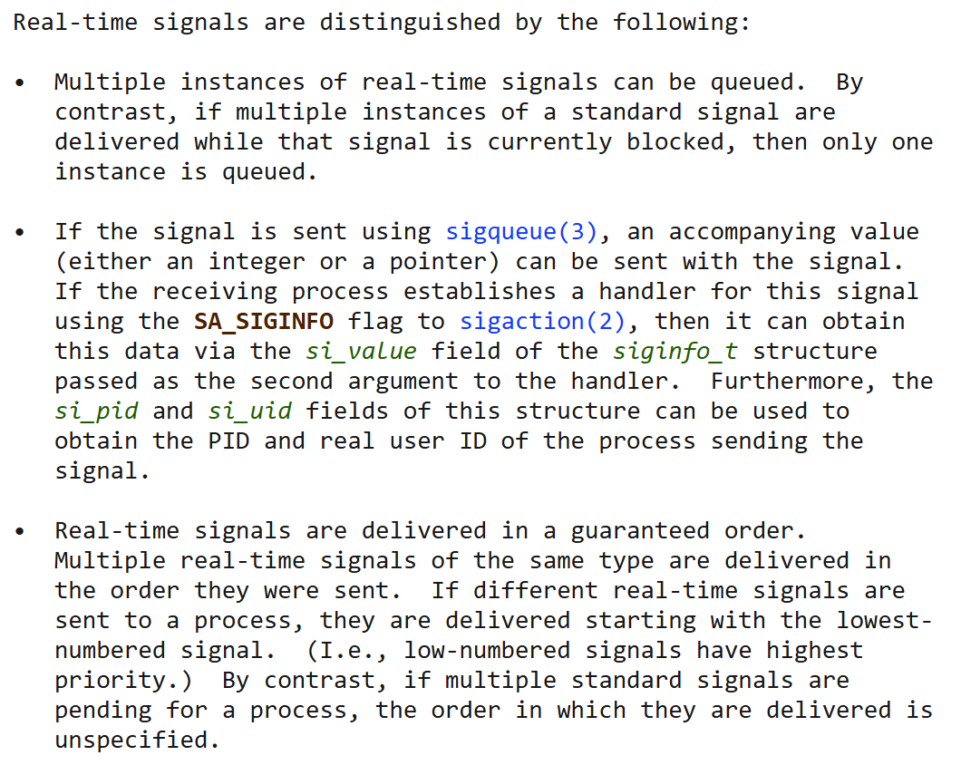
Signaling
signal(7) - Linux manual page

Slide 13
PARENT
C1
C2
C3
CHILD1
CHILD2
CHILD3
C1
C2
C3

Slide 14
Handle a signal using sigaction
We set/change the disposition of a signal by calling the sigaction function
  int sigaction(int signum, const struct sigaction *act, struct sigaction *oldact);
  struct sigaction {
void (*sa_handler)(int);
void (*sa_sigaction)(int, siginfo_t *, void *);
sigset_t sa_mask;
int sa_flags;
void (*sa_restorer)(void);
};

Slide 15
Handle a signal using sigaction
Three choices for the disposition:
  We can provide in sigaction a function that is called whenever a specific signal occurs (sa_handler)
  Prototype: void handler (int signo);
  We can ignore a signal by setting sa_handler to SIG_IGN
  We can set the default disposition for a signal by setting sa_handler to SIG_DFL.

Slide 16
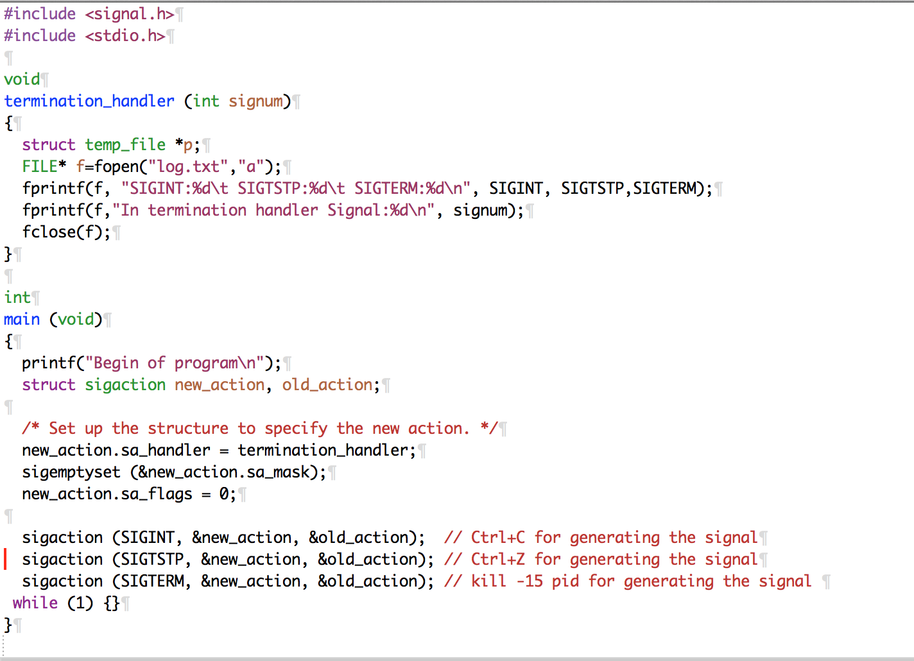
Example

Slide 17
Handle a signal using signal function
An alternative to use sigaction.
<signal.h>
void (*signal(int sig, void (*func)(int)))(int)
  Sig: signal to be handled
  func: a pointer to a function that handle the signal
  Meaning: registration of a function for handling a signal.

Slide 18
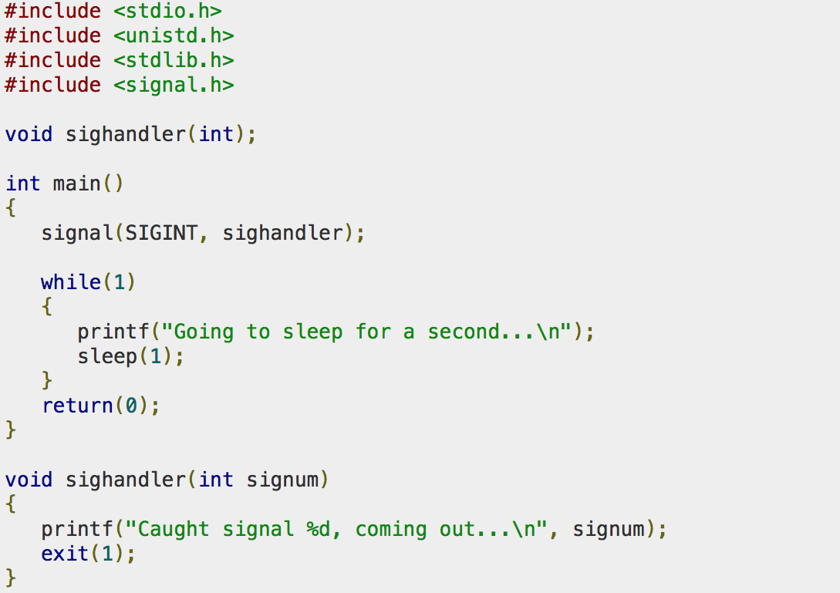
Example

Slide 19
Handling SIGCHLD Signals
The purpose of the zombie state is to maintain information about the child in “process table” for the parent to fetch at some later time.
This information includes the process ID of the child, its termination status, and information on the resource utilization of the child (CPU time, memory, etc.).
They take up space in the kernel and eventually we can run out of processes
Whenever we fork children, parent must wait (read exit status) for them to prevent them from becoming zombies
  establish a signal handler to catch SIGCHLD, and within the handler, we call wait
  Add into server: signal (SIGCHLD, handler);

Slide 20
wait() and waitpid()
#include <sys/wait.h>
pid_t wait (int *statloc);
pid_t waitpid (pid_t pid, int *statloc, int options);
Wait for the status change of a process. Status changes are:
  the child terminated;
  the child was stopped by a signal; or
  the child was resumed by a signal.
Use to handle the terminated child
Both return two values:
  The return value of the function
    is the process ID of the terminated child if OK
    0 or -1 if error
  The termination status of the child (an integer) is returned through the statloc pointer.

Slide 21
wait()
wait for state changes in a child of the calling process
In the case of a terminated child, performing a wait allows the system to release the resources associated with the child;
if a wait is not performed, then the terminated child remains in a "zombie" state

Slide 22
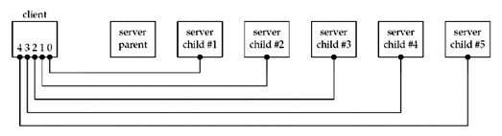
wait() vs waitpid()
Create 5 connections from a client to a forking server
When the client terminates, all open descriptors are closed automatically by the kernel
  → five connections ended simultaneous

Slide 23
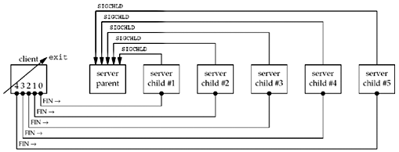
wait() vs waitpid()
→ five SIGCHILD is sent
The signal is handled once with wait () in the server
  → four children are zombies
It can happen when many users connect to a server
→ we have to use waitpid()

Slide 24
waitpid()
pid_t waitpid (pid_t pid, int *statloc, int options);
pid < 0: wait for status change of any child process whose process group ID is equal to the absolute value of pid.
pid = -1: wait for for status change of any child process.
pid = 0: wait for any child process whose process group ID is equal to that of the calling process
pid > 0: wait for the child whose process ID is equal to the value of pid
Without option WNOHANG, waitpid blocks until the status change
With option WNOHANG, waitpid returns immediately
Return
  Pid of the child whose state has changed
  With option WNOHANG, return 0 if the specified process has not changed status.

Slide 25
Forking server
pid_t pid;
int listenfd, connfd;
signal(SIGCHLD,sig_chld);
listenfd = socket( ... );
bind(listenfd, ... );
listen(listenfd, 5);
for ( ; ; ) {
  connfd = accept (listenfd, ... ); /* probably blocks */
  if( (pid = fork()) == 0) {
    close(listenfd); /* child closes listening socket */
    doit(connfd); /* process the request */
    close(connfd); /* done with this client */
    exit(0); /* child terminates */
  }else
  close(connfd); /* parent closes connected socket */
}

Slide 26
sig_chld: SIGCHLD handler
void sig_chld(int signo)
{
pid_t pid;
int stat;
while ( (pid = waitpid(-1, &stat, WNOHANG)) > 0)
printf("child %d terminated\n", pid);
return;
}
/*
WNOHANG: waitpid does not block
while loop: waitpid repeatedly until there is no child process change status, i.e until waitpid returns 0.
*/

Slide 27
Exercise
1) Make your TCP EchoServer be able to work with multiple client in the same time
  Use forking process
  Handle the SIGCHLD signal in server
2) Write a “chat room” forking server
  Accept connection from multiple clients
  Receive a message from one client then forward to all the others.

Slide 28
File Sharing
Viết một chương trình server và 1 client
  Server:
    Fork để tạo 1 tiến trình con chuyên recvfrom (6000) từ các client broadcast <TÊN> và lưu thông tin <IP> <TÊN> vào 1 file dùng chung.
    Fork để tạo 1 tiến trình con chuyên đợi TCP 5000 và accept: Mỗi lần accept tạo một kết nối và trả về danh sách các <IP> và <TÊN> cho client rồi đóng luôn kết nối.
  Client:
    Fork để tạo 1 tiến trình con chuyên broadcast tên (nhập từ bàn phím) đến cổng 6000 (toàn mạng)
    Fork để tạo 1 tiến trình con chuyên hỏi danh sách từ server:5000

Slide 29
Q&A

